Slide 1
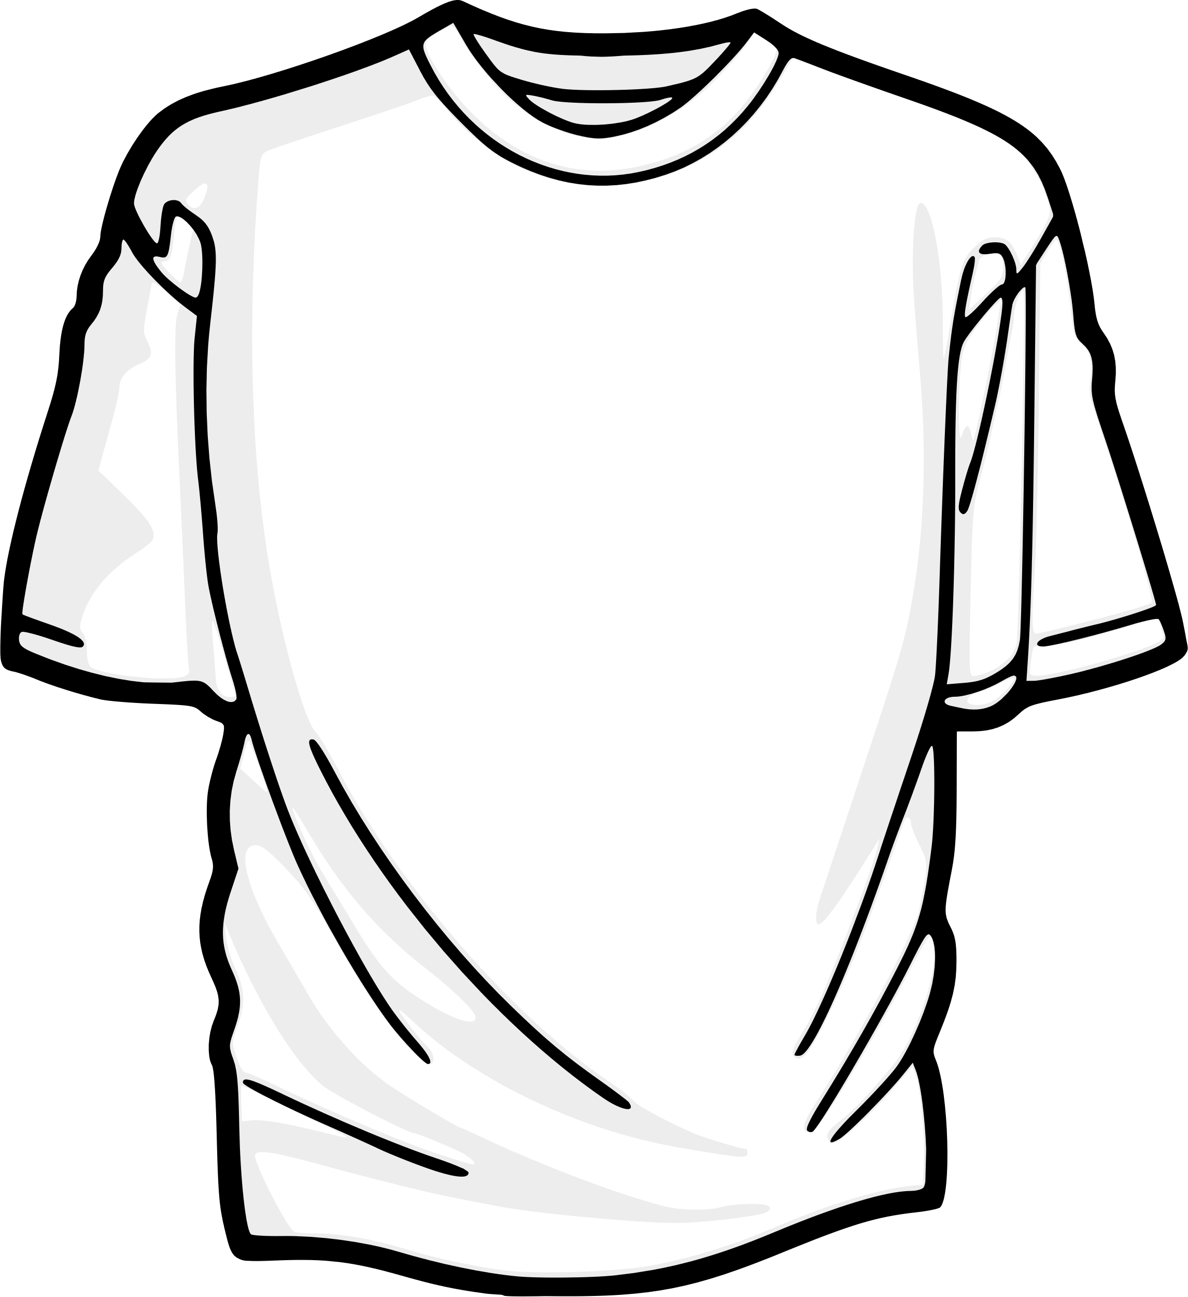
MACHINE LEARNING
PRODUCT SIZE
RECOMMENDATION
MENTOR: PROF MEHUL RAVAL
ADITI VASA - AU2040122
SHREY SOMANI - AU2040002
VANDAN SHAH - AU2040196
RONIT SHAH - AU2040048

Slide 2
INTRODUCTION
AIM: To solve the issue of uncertainty surrounding online shopping.
SOLUTION: By developing a machine learning model that predicts whether a product is fit or not, based on its attributes
WHY IS IT NECESSARY: To reduce product returns and provide customers with a better shopping experience.

Slide 3
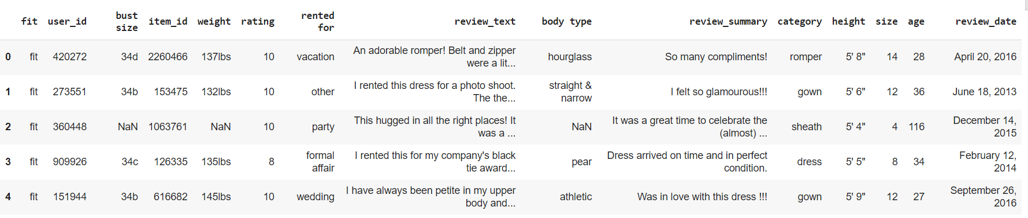
DATASET INFORMATION
DATASET SOURCE: KAGGLE
AUTHOR: Rishabh Mishra
INFORMATION: 1,90,000 X 15
[1]. Clothing Fit Dataset for Size Recommendation. (2018, August 21). Kaggle. https://www.kaggle.com/datasets/rmisra/clothing-fit-dataset-for-size-recommendation

Slide 4

PROBLEM STATEMENT
Assisting customers in predicting the size of the product that fits.
Developing machine learning model to reduce product returns due to size issue.
Main goal: Product Size Prediction using K-Nearest Neighbours and Random Forest Classification

Slide 5
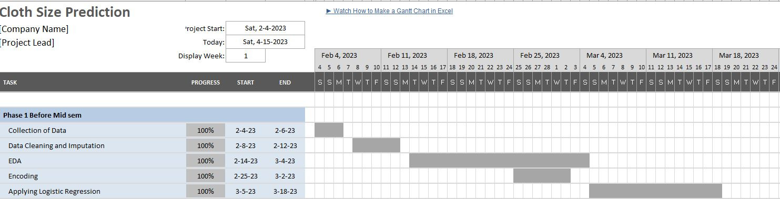
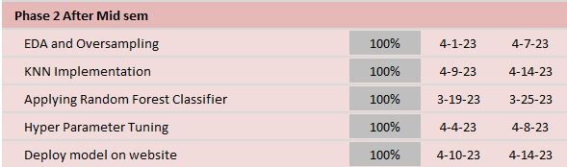
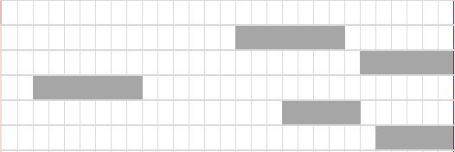
GAANT CHART

Slide 6
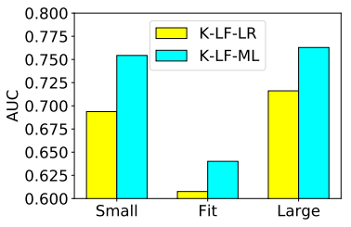
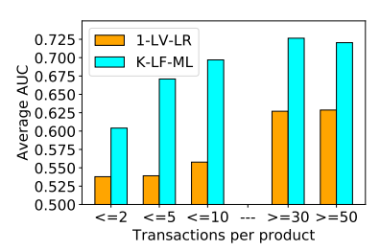
EXISTING BODY OF WORK
PREDICTING TRUE SIZE OF THE PRODUCT
BAYESIAN LOGIT REGRESSION MODELS WITH ORDINAL CATEGORIES TO MODEL FIT
CAPTURING FIT SEMANTICS AND HANDLE LABEL IMBALANCE ISSUES USING METRIC LEARNING APPROACHES
USING SKIP-GRAM MODELS TO LEARN CUSTOMERS’ AND PRODUCTS’ LATENT FEATURES
[2]. METRIC LEARNING APPROACH IN
CLASSIFYING INFREQUENT LABELS.
[2]. AVERAGE TEST AUC FOR PRODUCTS
WITH GIVEN NUMBER OF TRANSACTIONS.
[2]. Misra, R., Wan, M., & McAuley, J. (2018). Decomposing fit semantics for product size recommendation
in metric spaces. Conference on Recommender Systems. https://doi.org/10.1145/3240323.3240398

Slide 7
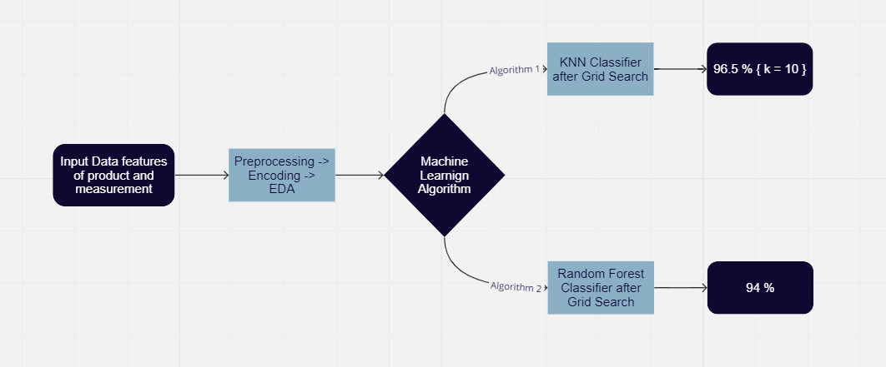
OUR APPROACH
1
DATA CLEANING AND PREPROCESSING
2
ENCODING
2
3
EXPLORATORY DATA ANALYSIS
4
OVERSAMPLING USING SMOTENC
5
RANDOM FOREST & KNN CLASSIFIER
6
HYPERPARAMETER TUNING USING GRID SEARCH
[3]. Flowchart. (n.d.). miro.com.
https://miro.com/app/board/uXjVMSsaeBA=/?share_link_id=269082615364

Slide 8
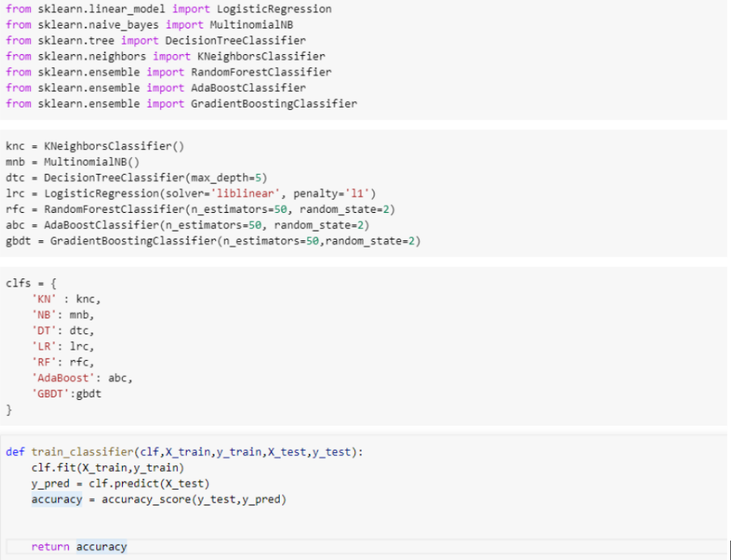
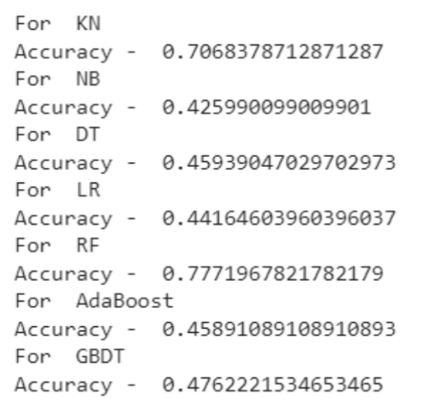
RESULTS:
ALGORITHMS
CODE
ACCURACY
[4]. CSE523-Machine-Learning-2022-Data-Dynamos-/Codes at main · vandanshah17/CSE523-Machine-Learning-2022-Data-Dynamos-. GitHub. https://github.com/vandanshah17/CSE523-Machine-Learning-2022-Data-Dynamos-/tree/main/Codes

Slide 9
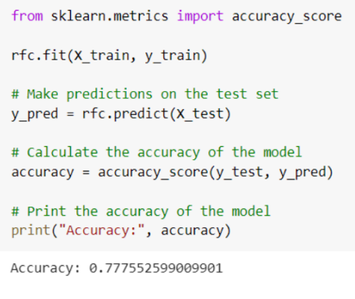
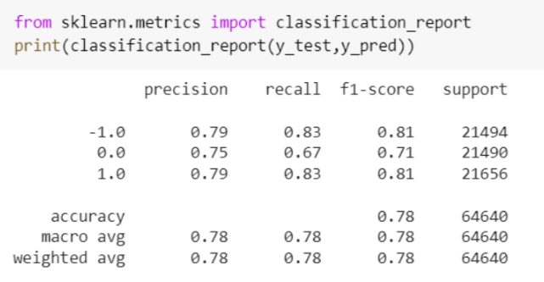
RESULTS:
RANDOM FOREST CLASSIFICATION
CODE
CLASSIFICATION REPORT
[4]. CSE523-Machine-Learning-2022-Data-Dynamos-/Codes at main · vandanshah17/CSE523-Machine-Learning-2022-Data-Dynamos-. GitHub. https://github.com/vandanshah17/CSE523-Machine-Learning-2022-Data-Dynamos-/tree/main/Codes

Slide 10
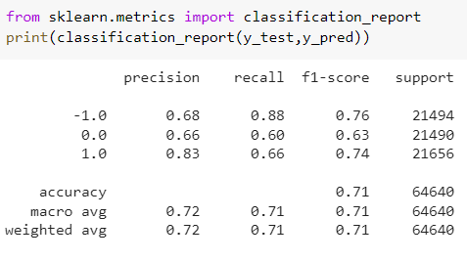
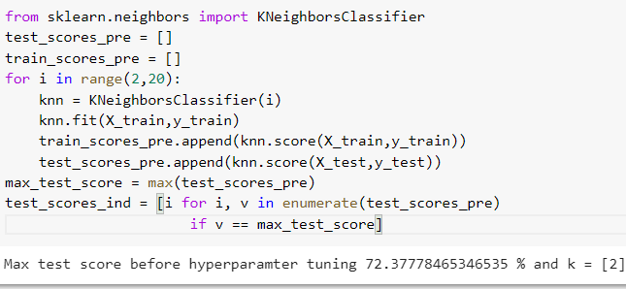
RESULTS:
K-NEAREST NEIGHBOURS
CODE
CLASSIFICATION REPORT
[4]. CSE523-Machine-Learning-2022-Data-Dynamos-/Codes at main · vandanshah17/CSE523-Machine-Learning-2022-Data-Dynamos-. GitHub. https://github.com/vandanshah17/CSE523-Machine-Learning-2022-Data-Dynamos-/tree/main/Codes

Slide 11
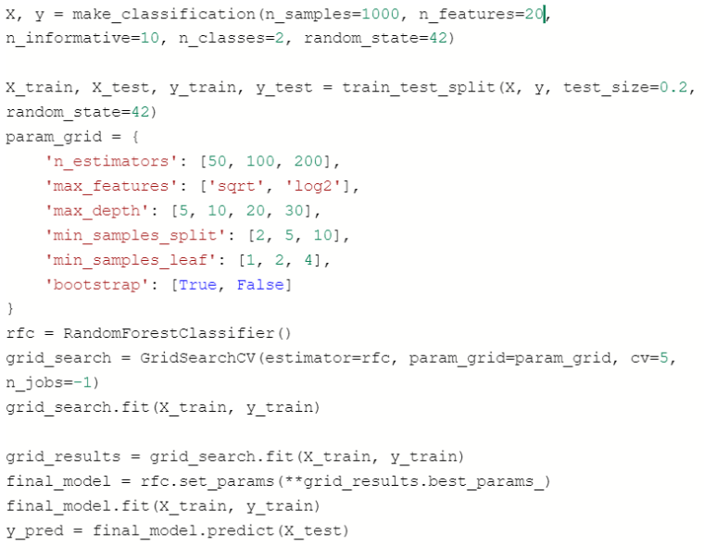
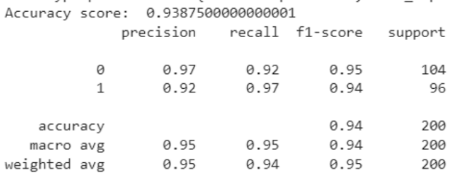
RESULTS:
RANDOM FOREST CLASSIFICATION AFTER GRIDSEARCH
CODE
CLASSIFICATION REPORT
[4]. CSE523-Machine-Learning-2022-Data-Dynamos-/Codes at main · vandanshah17/CSE523-Machine-Learning-2022-Data-Dynamos-. GitHub. https://github.com/vandanshah17/CSE523-Machine-Learning-2022-Data-Dynamos-/tree/main/Codes

Slide 12
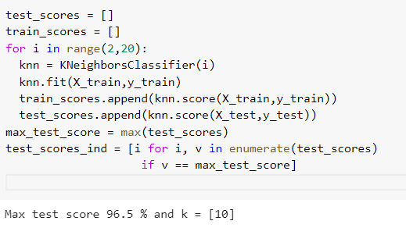
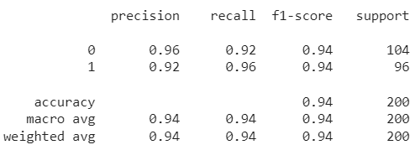
RESULTS:
K-NEAREST NEIGHBOURS AFTER GRIDSEARCH
CODE
CLASSIFICATION REPORT
[4]. CSE523-Machine-Learning-2022-Data-Dynamos-/Codes at main · vandanshah17/CSE523-Machine-Learning-2022-Data-Dynamos-. GitHub. https://github.com/vandanshah17/CSE523-Machine-Learning-2022-Data-Dynamos-/tree/main/Codes

Slide 13
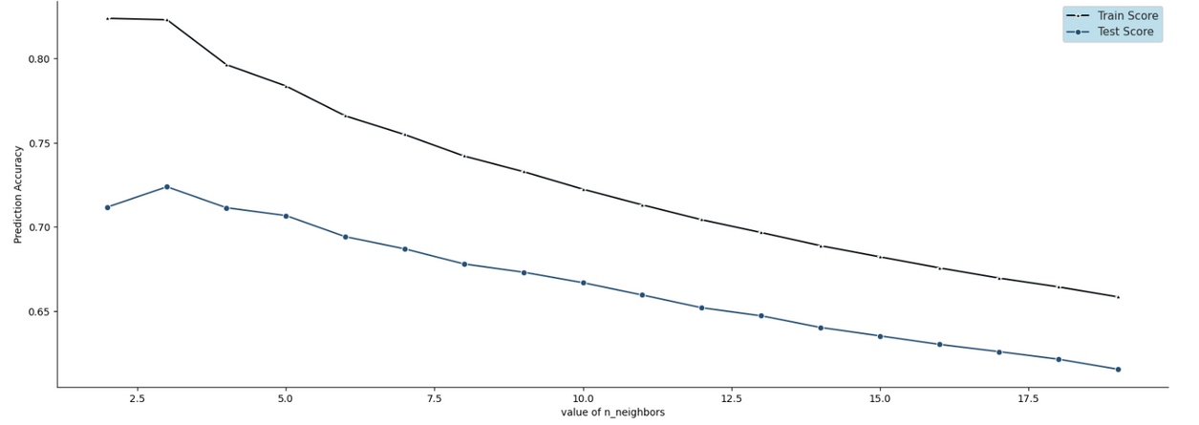
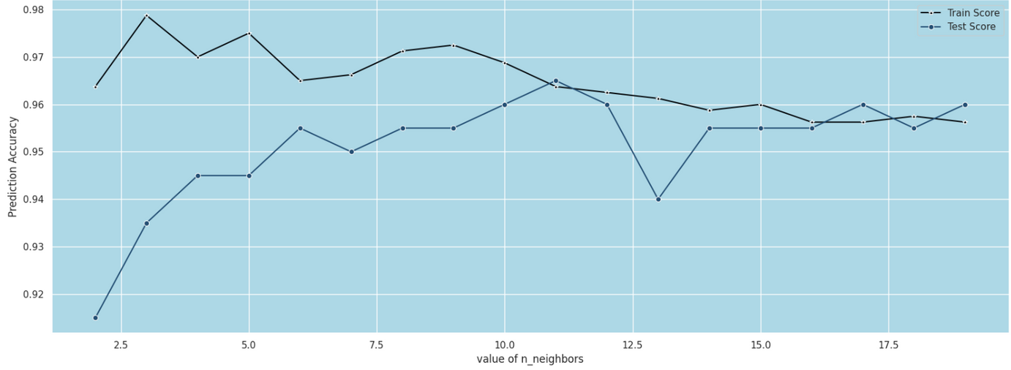
RESULTS:
GRAPH FOR KNN BEFORE
GRIDSEARCH:
PREDICTION ACCURACY
VS
N NEIGHBOURS
GRAPH FOR KNN AFTER
GRIDSEARCH:
PREDICTION ACCURACY
VS
N NEIGHBOURS
[4]. CSE523-Machine-Learning-2022-Data-Dynamos-/Codes at main · vandanshah17/CSE523-Machine-Learning-2022-Data-Dynamos-. GitHub. https://github.com/vandanshah17/CSE523-Machine-Learning-2022-Data-Dynamos-/tree/main/Codes

Slide 14
CONCLUSION
Random Forest and KNN algorithms perform well on classification problems with imbalanced data
Oversampling is necessary if the dataset is imbalanced.
Suboptimal hyperparameters can lead to underfitting or overfitting of the model
Possibilities of poor accuracy before applying Grid Search Hyperparameter Tuning:
Underfitting of data
Overfitting of data
Imabalanced Dataset

Slide 15
ROLE OF EACH GROUP MEMBER
Aditi Vasa-
Encoding of data, Applied Random Forest Classifier, and working on model deployment.
Shrey Somani-
EDA, Performance Metrics and hyper Parameter tuning on algorithms, Report, and Presentation
Vandan Shah-
Work on preprocessing of data, Applying regression algorithms, evaluating performance metrics, and Presentation part.
Ronit Shah-
Work on Data Cleaning part and applying KNN algorithm and working on Report.

Slide 16

REFERENCES
REFERENCES
[1]. Clothing Fit Dataset for Size Recommendation. (2018, August 21). Kaggle. https://www.kaggle.com/datasets/rmisra/clothing-fit-dataset-for-size-recommendation.
[2]. Misra, R., Wan, M., & McAuley, J. (2018). Decomposing fit semantics for product size recommendation in metric spaces. Conference on Recommender Systems. https://doi.org/10.1145/3240323.3240398
[3]. Flowchart. (n.d.). miro.com.
https://miro.com/app/board/uXjVMSsaeBA=/?share_link_id=269082615364
[4]. Vandanshah. (n.d.). CSE523-Machine-Learning-2022-Data-Dynamos-/Codes at main · vandanshah17/CSE523-Machine-Learning-2022-Data-Dynamos-.GitHub. https://github.com/vandanshah17/CSE523-Machine-Learning-2022-Data-Dynamos-/tree/main/Codes

